Slide 1
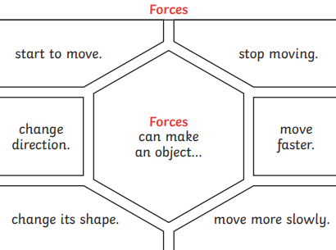
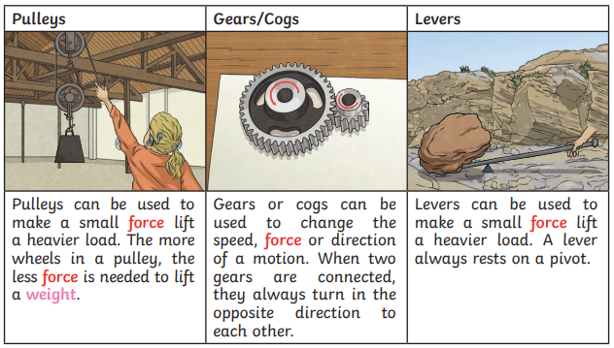
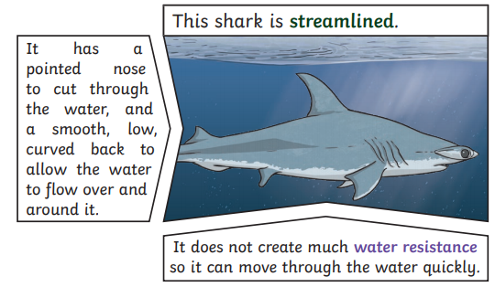
Year 5 | Science | Forces
Key Vocabulary
1 | Forces | Pushes or pulls.
2 | Gravity | A pulling forces exerted by the Earth (or anything else which has mass).
3 | Weight | The measure of the force of gravity of an object.
4 | Mass | A measure of how much matter (or stuff) is inside an object.
5 | Friction | A force that acts between two surfaces or objects that are moving, or trying to move across each other.
6 | Air resistance | A type of friction caused by air pushing against any moving object.
7 | Water resistance | A type of friction caused by water pushing against any moving object.
8 | Buoyancy | An upward force that a liquid applies to objects.
Key Knowledge
1 | Isaac Newton is famously thought to have developed his theory of gravity when an apple fell to the ground from a tree.
2 | The moon has a smaller mass than Earth so the gravitational pull on the moon is smaller than it is on Earth.
3 | Jupiter has a greater mass than Earth. So the gravitational pull on Jupiter is stronger than on Earth.
4 | Water resistance and air resistance are forms of friction. Friction is sometimes helpful and sometimes unhelpful. For example, air resistance is helpful as it stops a skydiver hitting the ground at a speed. Friction on a bike chain can make the bike harder to pedal so it is unhelpful.
5 | Mass is how much matter is inside an object and it is measured in kilograms (kg).
6 | Weight is how strongly gravity is pulling an object down. It is measured in Newtons (N).
Useful Diagrams
1
2
3
9 | Streamlined | When an object is shaped to minimise the effects of air and water resistance.
FUN FACT!
The wind is a force. Even biting, twisting, stretching, lifting and loads of other things we do every day are also forces.
Every time something happens, a force is right there doing its work!
10 | Mechanism | Parts which work together in a machine. Examples of mechanisms are pulleys, levers and gears.

