Slide 1

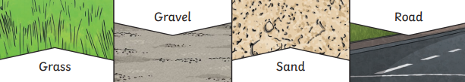
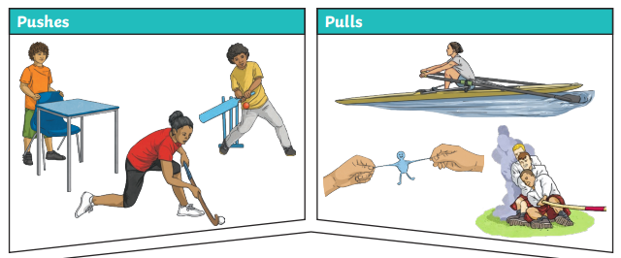
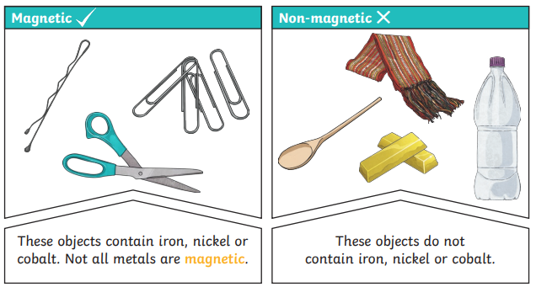
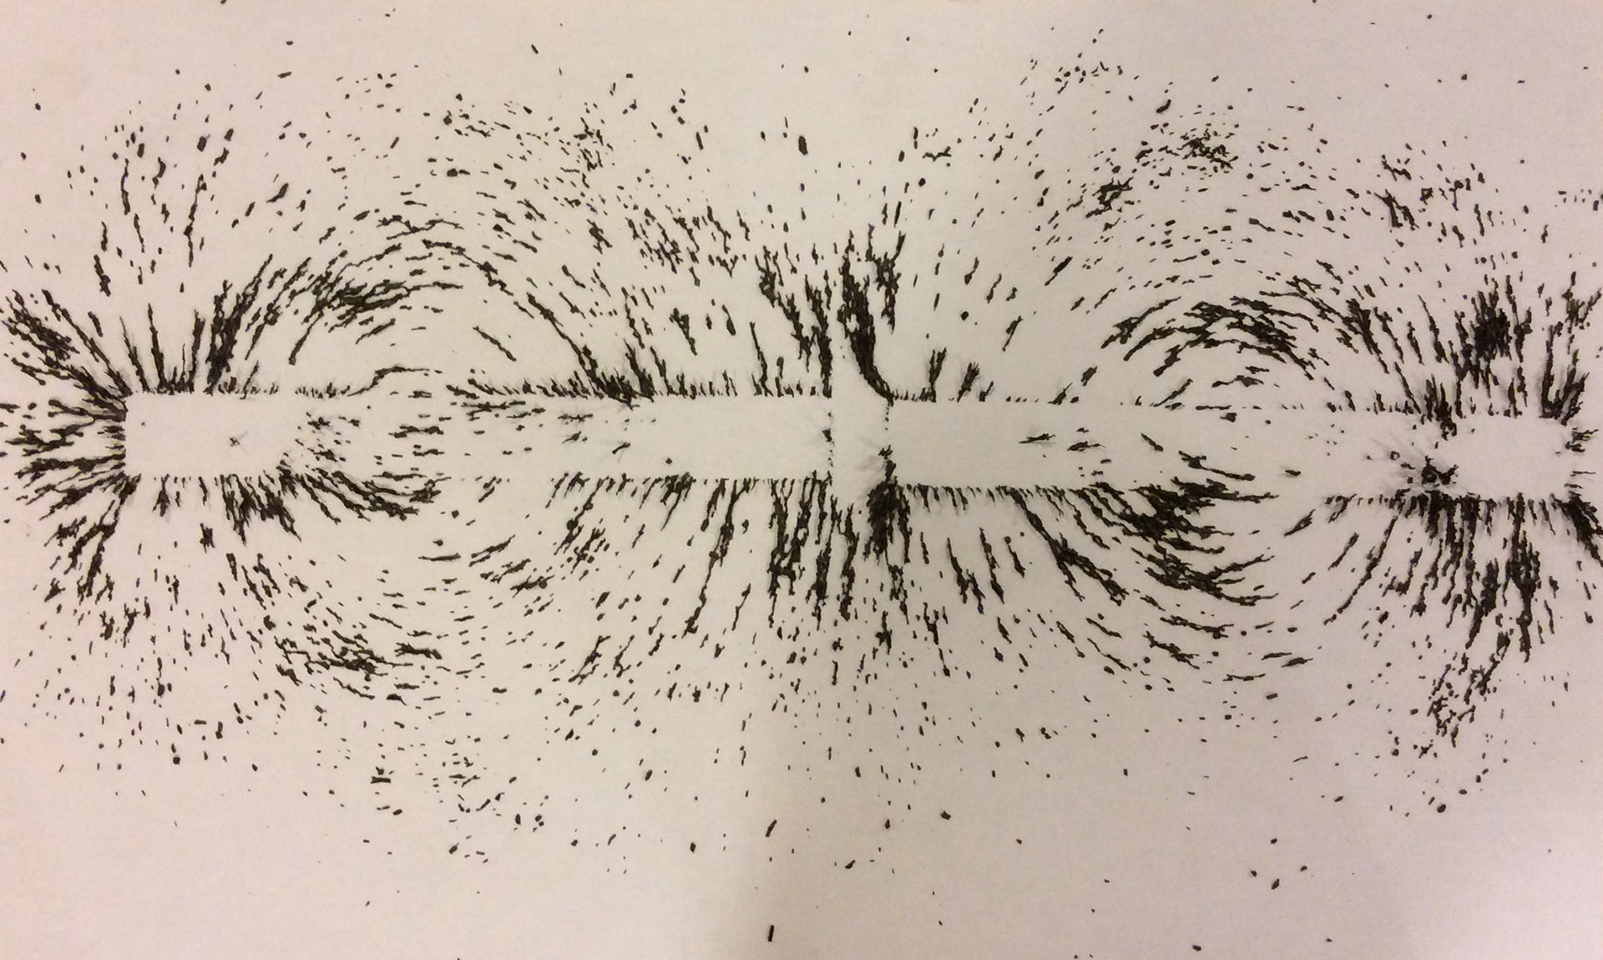
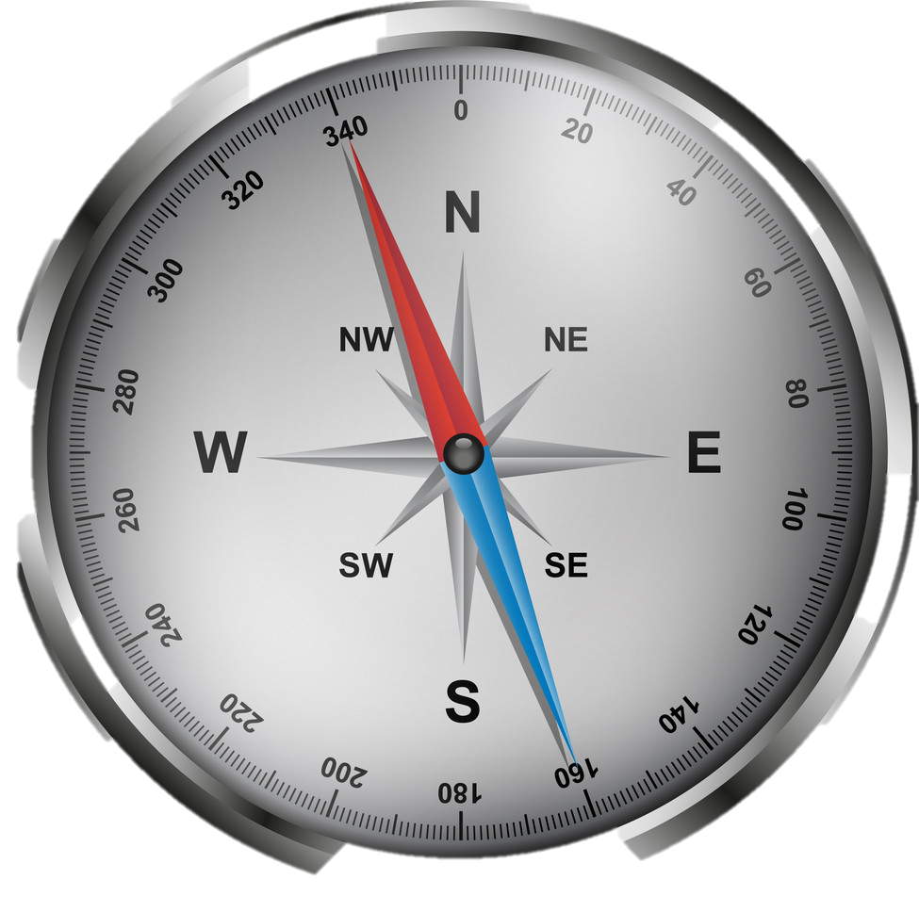
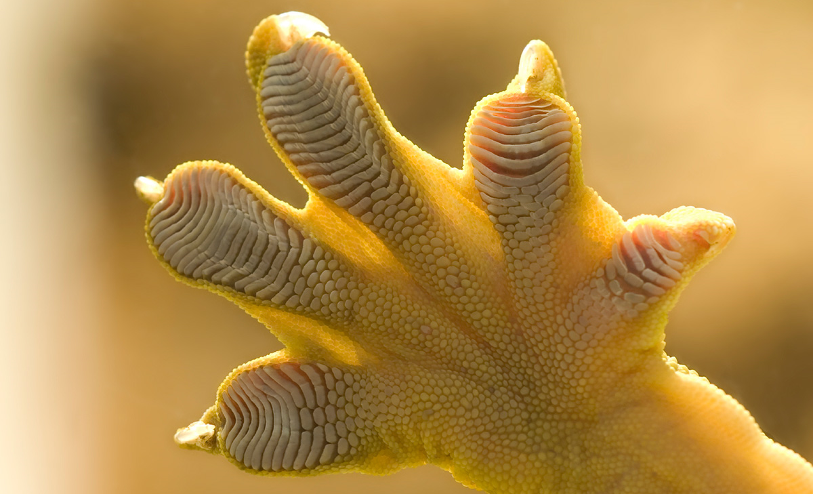
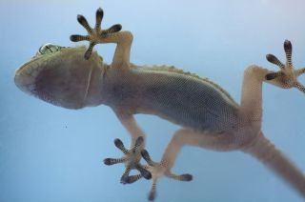
Year 3 | Science | Forces and Magnets
Key Vocabulary
1 | Forces | Pushes or pulls.
2 | Friction | A force that acts between two surfaces or objects that are moving, or trying to move, across each other.
3 | Surface | The top layer of something.
4 | Magnet | An object that produces a magnetic force that pulls certain objects towards it.
5 | Magnetic | Objects which are attracted to a magnet are magnetic. Objects containing iron, cobalt or nickel are magnetic.
6 | Poles | North and south poles are found at different ends of a magnet
7 | Repel | Repulsion is a force that pushes objects away. For example, when a north pole is placed near the north pole of another magnet, the two poles repel (push away from each other).
8 | Attract | Attraction is a force that pulls objects together. For example, when a north pole is placed near a south pole of another magnet, the two poles attract (pull together).
Key Knowledge
1 | Different surfaces create different amounts of friction
2 | The amount of friction created by an object moving over a surface depends on the roughness of the surface and the object, and the force between them.
3 | Forces will change the motion of an object. They will either make it start to move, speed up, slow it down or even make it stop.
4 | Like poles repel and opposite poles attract.
5 | A magnetic field is invisible. In this example you can see the magnetic field. This is what happens when the iron filings are placed on top of a piece of paper with a magnet underneath.
6 | The needle of a compass is a magnet. A compass always points north-south on Earth.
Useful Diagrams
1
2
3
FUN FACT!
It is because of forces that geckos can stick to walls!

