Slide 1
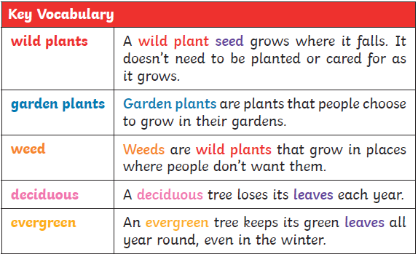
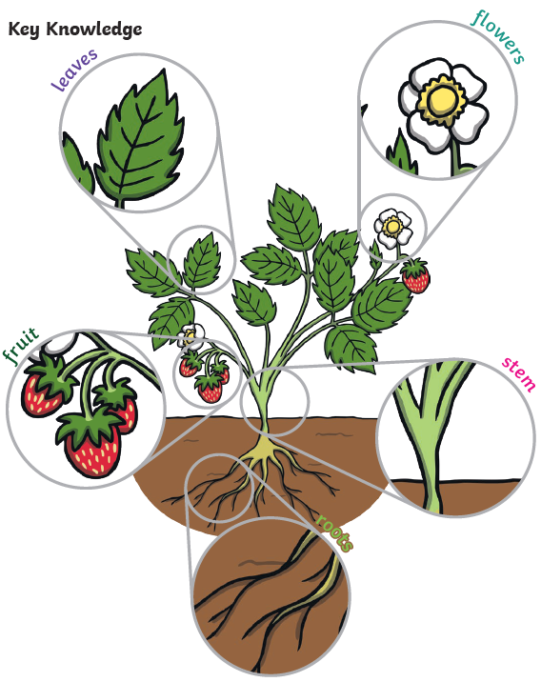
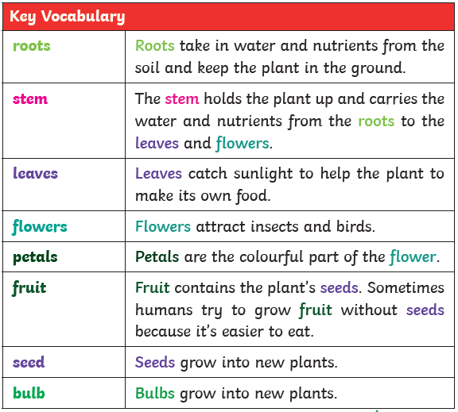
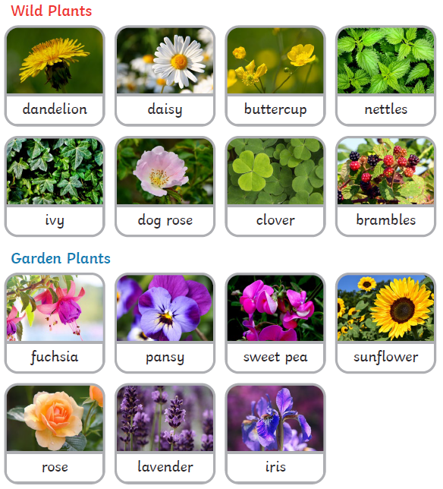
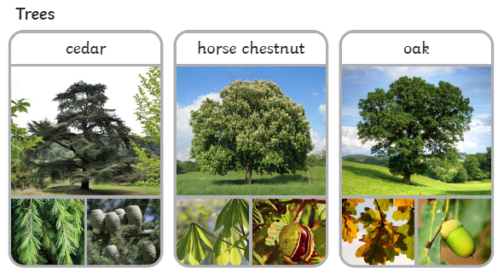
Key Skills (Working Scientifically)
Identifying and classifying plants and trees
Using observations to answer questions
Performing simple tests
Observing closely, using simple equipment
Year 1
‘Plants’ Knowledge Organiser

