Slide 1
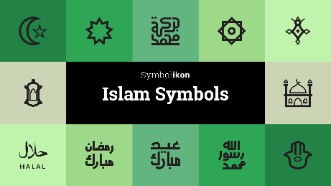
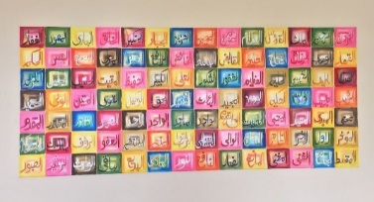
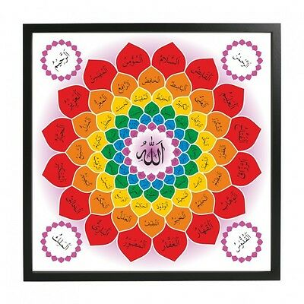
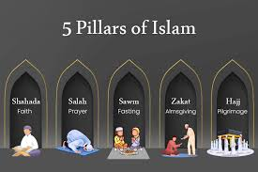
Year 2 Religious Education Knowledge Organiser
Unit 1 Who is a Muslim and how do they live? (part 1)
Religious Education helps pupils to make sense of religion and worldviews, reflecting on their own ideas and ways of living
Key Theological Vocabulary
Muslim a follower of the religion of Islam
Shahadah the statement that Muslims say to show what they believe about God
God/Allah A divine/holy being/leader that is important in the lives of Muslims
Qur’an Muslim holy book
Prophet Muhammad (PBUH-peace be upon him) Religious leader/prophet of Allah who received the words of the Qu’ran
99 names of God :
What we will learn
Making sense of belief
Recognise the words of the Shahadah and that it is very important for Muslims
Identify some of the key Muslim beliefs about God found in the Shahadah and the 99 names of Allah, and give a simple description of what some of them mean
Give examples of how stories about the Prophet show what Muslims believe about Muhammad
Making connections
Think, talk about and ask questions about Muslim beliefs and ways of living
Talk about what they think is good for Muslims about prayer, respect, celebration and self-control, giving a good reason for their ideas
Give a good reason for their ideas about whether prayer, respect, celebration and self-control have something to say to them too
Understanding Impact
Give examples of how Muslims use the Shahadah to show what matters to them
Give examples of how Muslims use stories about the Prophet to guide their beliefs and actions (e.g. care for creation, fast in Ramadan)
Give examples of how Muslims put their beliefs about prayer into action.
Lent and Easter Week

Slide 2
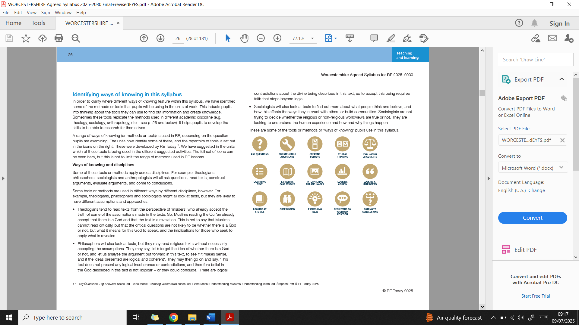
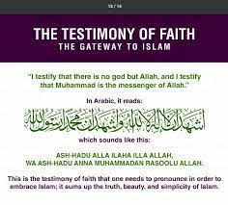
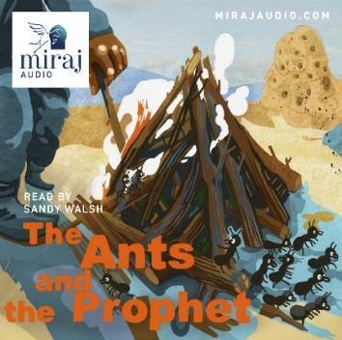
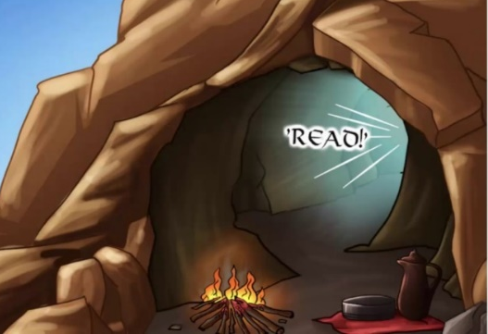
Ways of Knowing:
Lens used
Shahadah
Prophet Muhammad (PBUH)
Being Theologians with Thea and Theo
Being Human and Social scientists with Hunter and Sofia
Being Philosophers with Phoebe and Pharell

