Slide 1
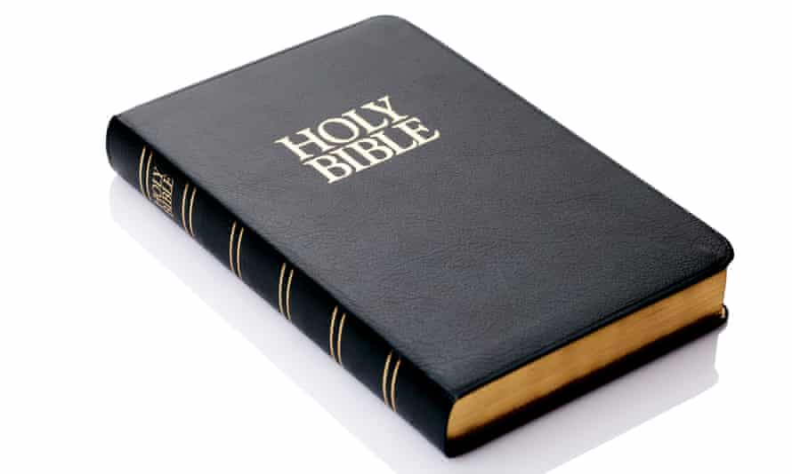
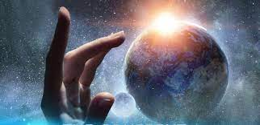
Year 6 Religious Education Knowledge Organiser Unit 1 Creation and Science: Conflicting or Complementary?
Religious Education helps pupils to make sense of religion and worldviews, reflecting on their own ideas and ways of living
Key Theological Vocabulary
Christian-A person who follows and believes in the teachings of The Trinity/Christianity
Bible-The holy book that Christians read to learn more and guide them in their beliefs..
Old Testament-The first part of the Bible, used by both Christian and Jewish (Hebrew Bible) people to guide their lives.
God-Christians believe in one God. A divine, holy being who they believe created the world.
Omnipotent the quality of having unlimited power such as a deity or god.
Creator-a person or thing that brings something into existence
What we will learn
Making sense of belief
Outline the importance of Creation on the timeline of ‘the big story’ of the Bible.
Identify what type of text some Christians say Genesis 1 is, and its purpose.
Taking account of the context, suggest what Genesis 1 might mean, and compare their ideas with ways in which Christians interpret it, showing awareness of different interpretations.
Making connections
Identify key ideas arising from their study of Genesis 1 and comment on how far these are helpful or inspiring, justifying their responses.
Weigh up how far the Genesis 1 creation narrative is in conflict, or is complementary, with a scientific account, giving good reasons for their views.
Understanding Impact
Make clear connections between Genesis 1 and Christian belief about God as Creator.
Show understanding of why many Christians find faith and science go together.

Slide 2
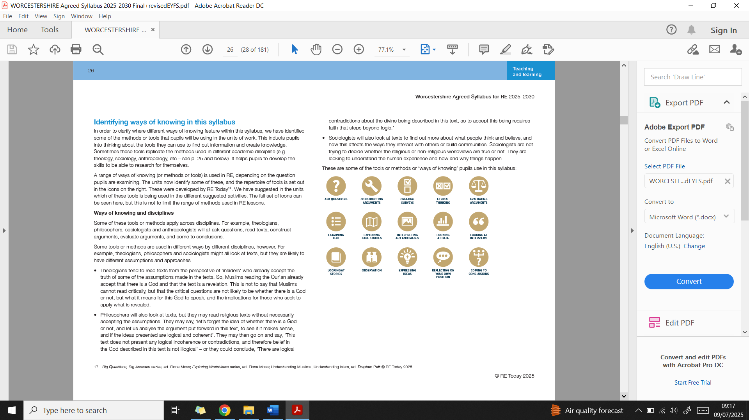
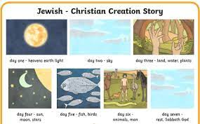
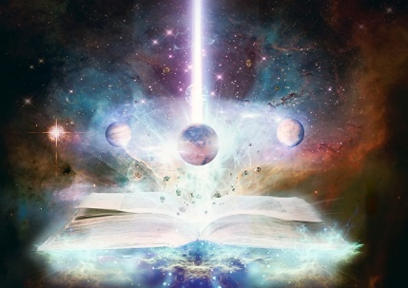
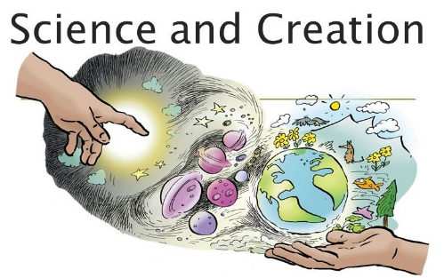
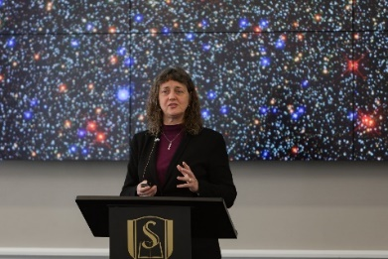
Ways of Knowing:
Lens used
Being Theologians with Thea and Theo
Being Human and Social scientists with Hunter and Sofia
Jennifer Wiseman is an American astronomer and has a degree in Physics and PhD in astronomy. She is also a Christian.
Being Philosophers with Phoebe and Pharell

