Slide 1
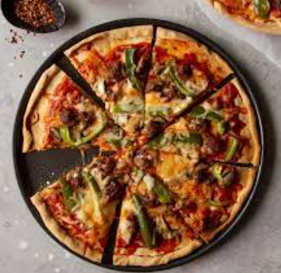
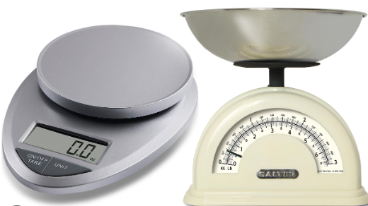
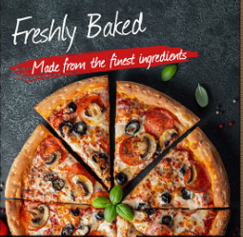
Key Vocabulary
Grams | Unit of measurement to weigh ingredients
Dough | a thick, malleable mixture of flour and liquid, used for baking into bread or pastry
Savoury | belonging to the category that is salty or spicy rather than sweet.
Sieve | a utensil consisting of a wire or plastic mesh held in a frame, used for straining solids from liquids
Yeast | Tiny organisms that are used in making bread and other food and drinks.
Flavour | The distinctive taste of a food or drink.
Perfect pizzas
Year 6
Knowledge organiser
The Design Process
Evaluate Existing Products – look at a range of products to gather my own ideas
Focused Practical Tasks – practise the skills that I will need
Design – design my own product
Make – use my design and the skills I practised to make my own product
Evaluate – try my product t see if it works and that it meets my design brief
Key Skills
Carefully measure ingredients
Following a recipe step by step
Use appropriate vocabulary to describe flavours

