Slide 1
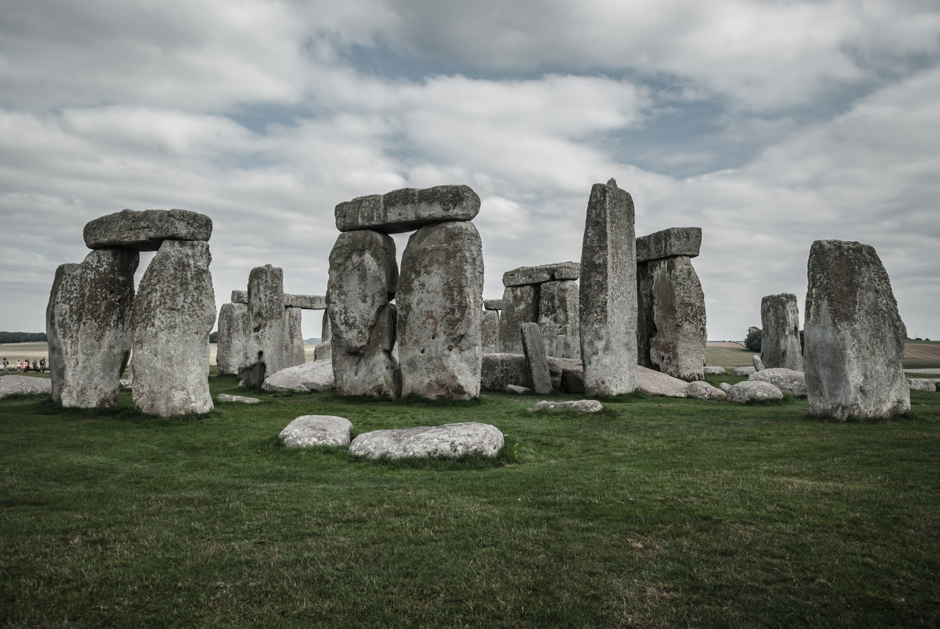
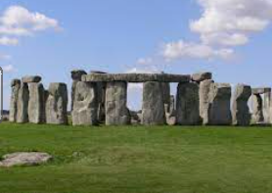
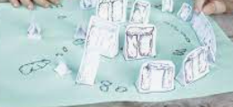
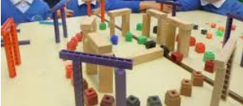
Key Vocabulary
Structure | A building or other object constructed from several parts.
Join | Link or connect components (parts) together.
Nets | A paper template to create a 3D shape.
Stable | An object or structure which is not likely to give way or overturn. The structure is firmly fixed.
Strengthen | To make something stronger either sections or whole structures.
Measure | To find the correct length or amount using a device marked in standard units. (e.g ruler measuring in cm)
The Design Process
Evaluate Existing Products – look at a range of products to gather my own ideas
Focused Practical Tasks – practise the skills that I will need
Design – design my own product
Make – use my design and the skills I practised to make my own product
Evaluate – try my product t see if it works and that it meets my design brief
Key Skills
Investigating ways of strengthening of materials.
Joining materials and component parts.
Measure and cut accurately
Building Blocks- Stonehenge Big Build
Construction – Stable Structures
Year 3
Knowledge organiser

