Slide 1
Year 1 Religious Education Knowledge Organiser Summer 1 Who do Christians say made the world? Religious Education explores big questions about life, to find out what people believe and what difference this makes to how they live.
Key Vocabulary and Terms
Jew-A person/people who follow the beliefs and teachings of Judaism.
God-Jews and Christians believe in one Creator God who cares for all people and created the world.
Christian-A person who follows and believes in the teachings of Jesus, God and the Holy Spirit.
Bible-a religious holy book that is special to Christians, Jews and Samaritans.
Creator-a person or thing that brings something into existence
What we will learn:
Make sense of belief:
Retell the story of creation from Genesis 1:1–2:3 simply
Recognise that ‘Creation’ is the beginning of the ‘big story’ of the Bible
Say what the story tells Christians about God, Creation and the world
Understand the impact:
• Give at least one example of what Christians do to say ‘thank you’ to God for Creation
Make connections:
• Think, talk and ask questions about living in an amazing world
Give a reason for the ideas they have and the connections they make between the Jewish/Christian Creation story and the world they live in
Lent and Easter Week

Slide 2
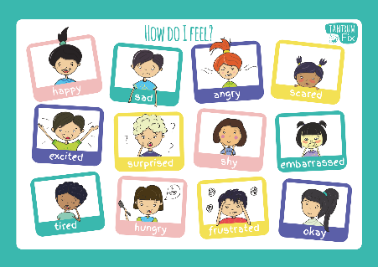
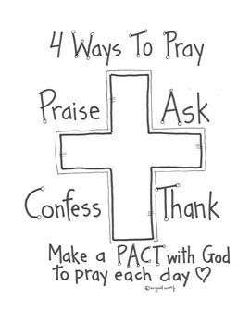
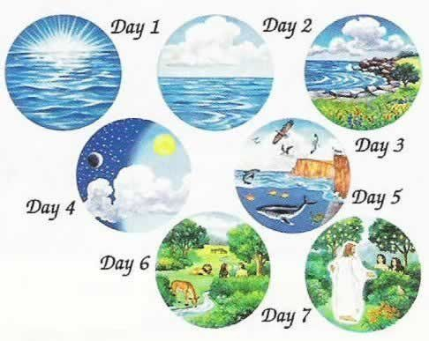
Feelings.
Creation Story Genesis
Prayer

