Slide 1
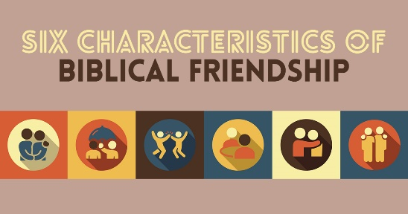
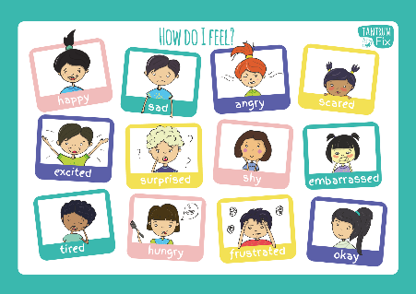
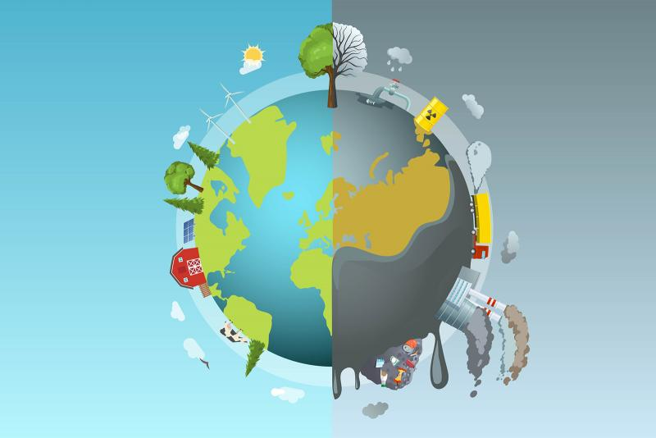
Year 1 Religious Education Knowledge Organiser
Summer 2 How should we care for others and the world?
Religious Education explores big questions about life, to find out what people believe and what difference this makes to how they live.
Key Vocabulary and Terms
Jew/Jewish-A person/people who follow the beliefs and teachings of Judaism.
God-Jews and Christians believe in one Creator God who cares for all people and created the world.
Christian-A person who follows and believes in the teachings of Jesus, God and the Holy Spirit.
Bible-a religious holy book that is special to Christians, Jews and Samaritans.
Creator-a person or thing that brings something into existence
Tzedek-Jewish idea of charitable giving
Tikkun Olam-Jewish duty to mend the world
What we will learn:
Make sense of belief:
Identify a story or text that says something about each person being unique and valuable
Give an example of a key belief some people find in one of these stories (e.g. that God loves all people)
Give a clear, simple account of what Genesis 1 tells Christians and Jews about the natural world
Understand the impact:
Give an example of how people show that they care for others (e.g. by giving to charity), making a link to one of the stories
Give examples of how Christians and Jews can show care for the natural earth
Say why Christians and Jews might look after the natural world
Make connections:
Think, talk and ask questions about what difference believing in God makes to how people treat each other and the natural world
Give good reasons why everyone (religious and non-religious) should care for others and look after the natural world.
Lent and Easter Week

Slide 2
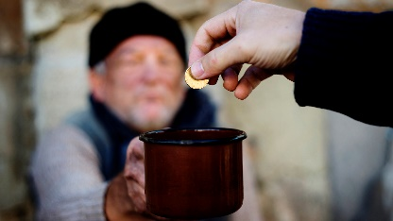

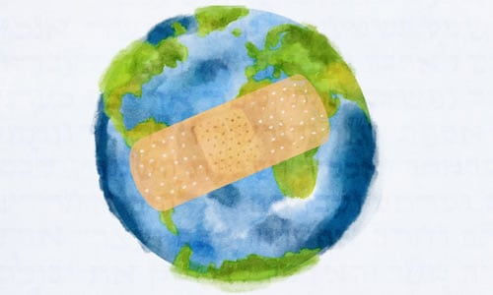
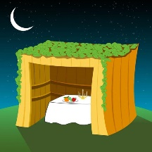
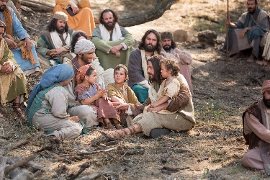
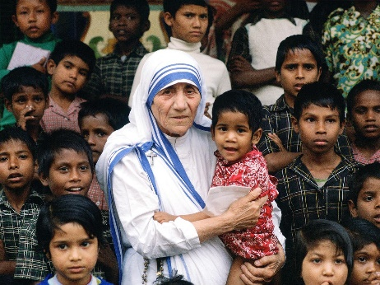
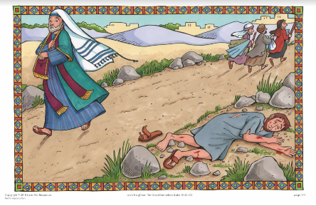
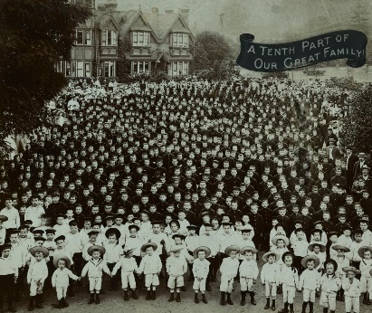
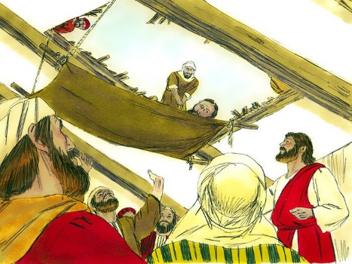
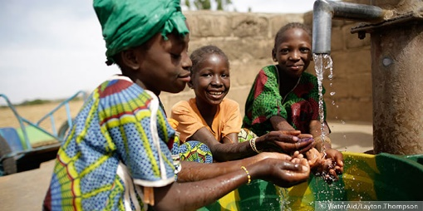
Jewish ideas
Tikkun Olam
Sukkot
Tzedekah
Christian ideas
Caring for others /charity work
The children come to Jesus
Mother Theresa
The Good Samaritan
Dr. Barnardo
Lowering the man through the roof to Jesus
Water Aid

