Slide 1
Year 4 Religious Education Knowledge Organiser Autumn 1 What is the Trinity and why is it important for Christians?(Incarnation/God)
Key Vocabulary and Terms
Christian-A person who follows and believes in the teachings of Jesus, God and the Holy Spirit
Trinity-Christians believe God is 3 in one-Father, son and Holy Spirit
Gospel-There are 4 gospels in the Bible. Christians believe in the ‘good news’ that Jesus brings in these stories
baptism-Christians believe that baptising cleanses people from original sin and marks a person's official entry into the Church.
God-Christian people believe in one God. A divine, holy being who they believe created the world.
Jesus-Christians believe that he is God who has come to earth, as flesh, to rescue humanity (Incarnation)
Holy Spirit-the third part of the Trinity. In the Gospels the Holy Spirit appears as a dove and as flames in another account.
What we will learn
Making sense of belief
Recognise what a ‘Gospel’ is and give an example of the kinds of stories it contains
Offer suggestions about what texts about Baptism and Trinity mean
Give examples of what these texts mean to some Christians today
Making connections
Make links between some Bible texts studied and the idea of God in Christianity, expressing clearly some ideas of their own about what Christians believe God is like
Understanding Impact
Describe how Christians show their beliefs about God the Trinity in worship in different ways (in baptism and prayer, for example) and in the way they live

Slide 2
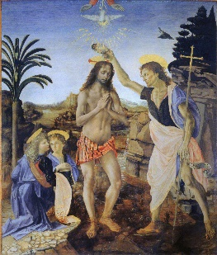
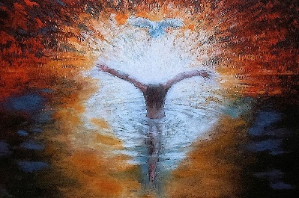
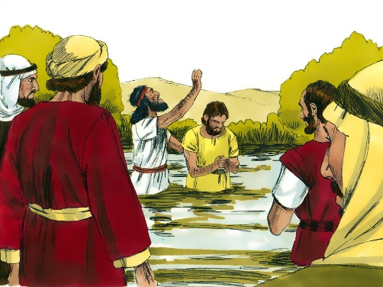
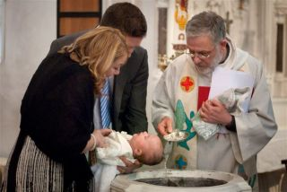
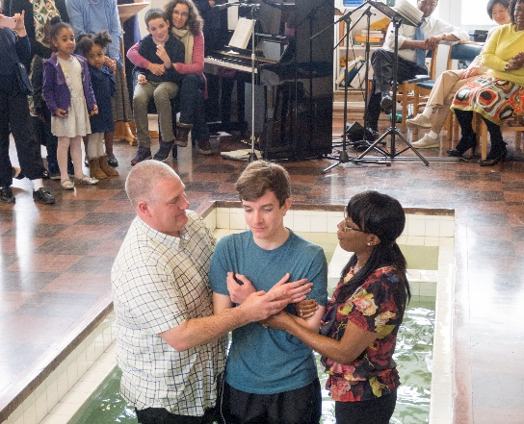
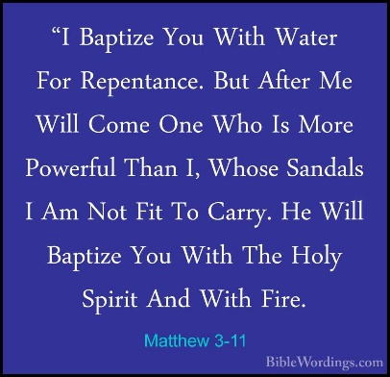
Baptism of Jesus
Verrochio
Daniel Bonnel
Baptism of Jesus
Christian infant and adult baptism
The baptism of Jesus is recorded in the Gospel of Matthew 3: 11-17.
He was baptised by John the Baptist in the River Jordan
This was the first sighting of the symbolism of the Holy Spirit-a dove came to rest above Jesus’ head.

